Slide 1
COLLEGE REVIEW WEBSITE
By BARATH

Slide 2
Abstract
The College Review Website is designed to provide students with a comprehensive platform for accessing college information, educational blogs, and course details. Aimed at helping prospective students make informed academic choices, the website combines a user-friendly interface with mobile and desktop accessibility. Key features include detailed college reviews, regularly updated educational content, and easy navigation. This project offers a valuable resource for students exploring their academic and career options.
Keywords: College Review, Educational Blogs, Course Details, Academic Choices, Student Resources, User-Friendly Design, Mobile Accessibility

Slide 3
Introduction
The College Review Website is an informative platform developed to support prospective students in making well-informed decisions about their academic futures. It provides a centralized resource where students can access comprehensive details about colleges, including facilities, locations, and academic programs. Additionally, the site features educational blogs that cover a range of topics, from study tips to career advice, and a dedicated section for course details, giving users an in-depth look at available educational pathways. Designed for accessibility on both mobile and desktop devices, the website aims to create a seamless and user-friendly experience, empowering students with relevant and reliable information as they navigate their educational journeys.

Slide 4
Key Features
Comprehensive College Information: Provides details on various colleges, including location, facilities, and academic programs, helping students compare and make informed decisions.
Student Review Section: Allows students to submit reviews and rate colleges based on their experiences, helping future users make informed choices based on peer feedback.
Course Details: Detailed information on available courses across different fields, including prerequisites, duration, and curriculum highlights.
User-Friendly Interface: Designed with intuitive navigation to ensure ease of use, allowing users to quickly access information.
Mobile and Desktop Accessibility: Optimized to work seamlessly on both mobile and desktop devices, offering flexibility in access.
Web Hosting on InfinityFree: Hosted on the InfinityFree platform for free, ensuring easy access and availability.

Slide 5
  College Information: Provides detailed profiles on colleges, including location, programs, facilities, and ratings.
  Blog Section: Features educational articles on study tips, career advice, and college guidance.
  Courses Information: Lists detailed course information, including prerequisites, structure, and career pathways.
  Easy Menu: Provides a simple menu that lets users quickly find and access different parts of the website, like Colleges, Blogs, Courses, Reviews, and Contact info.
  Reviews & Contact: Lets students leave reviews and ratings on colleges and includes a contact form for inquiries.
  Responsive Design: Ensures a consistent experience across mobile and desktop devices.
Modules Description

Slide 6
Hardware and Software requirements
Hardware Requirements :
Devices : Compatible with laptops, desktops, tablets, and smartphones.
Internet Connection : Requires a stable internet connection for optimal performance.
Software Requirements :
Frontend Technologies : HTML, CSS, and JavaScript for building the website.
Web Browser : Latest versions of Chrome, Firefox, Safari, or Edge for best compatibility.
Hosting Platform : Hosted on InfinityFree for online accessibility.

Slide 7
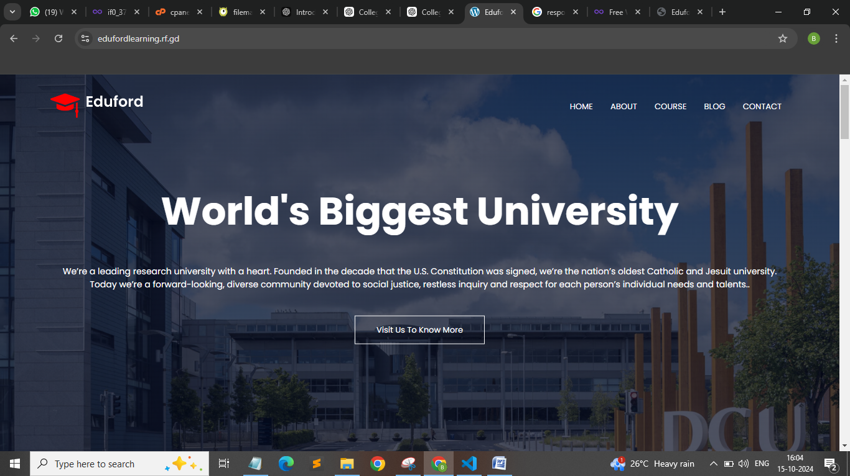
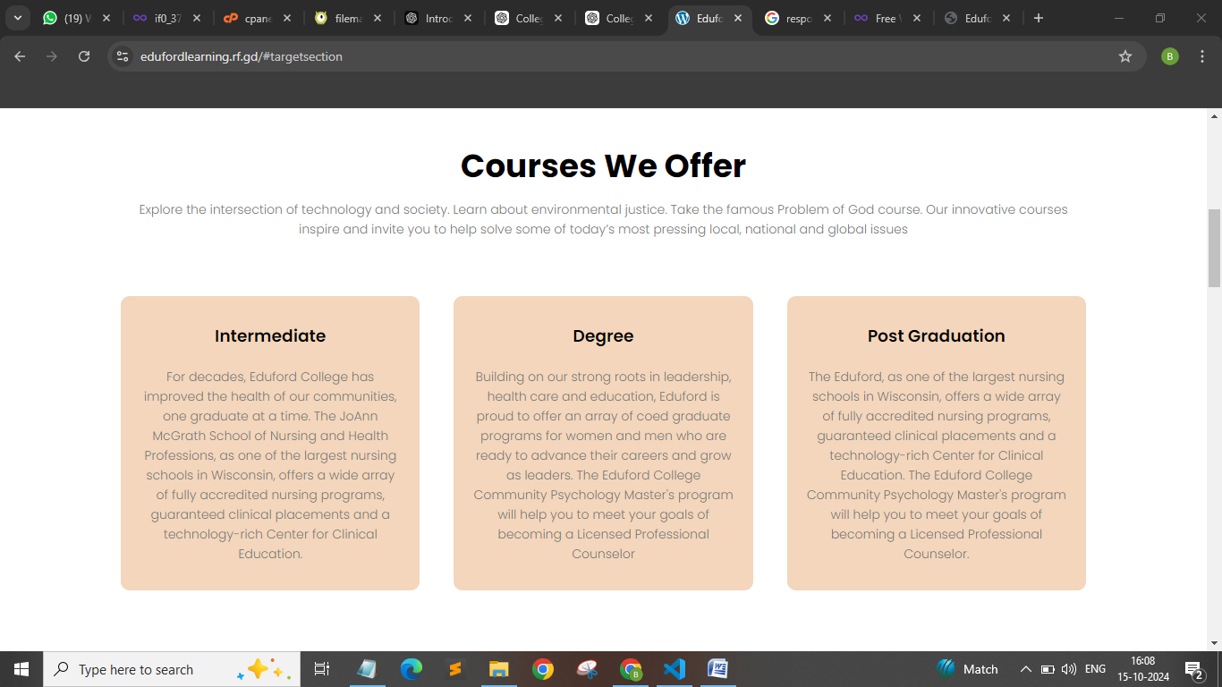
Screenshots

Slide 8
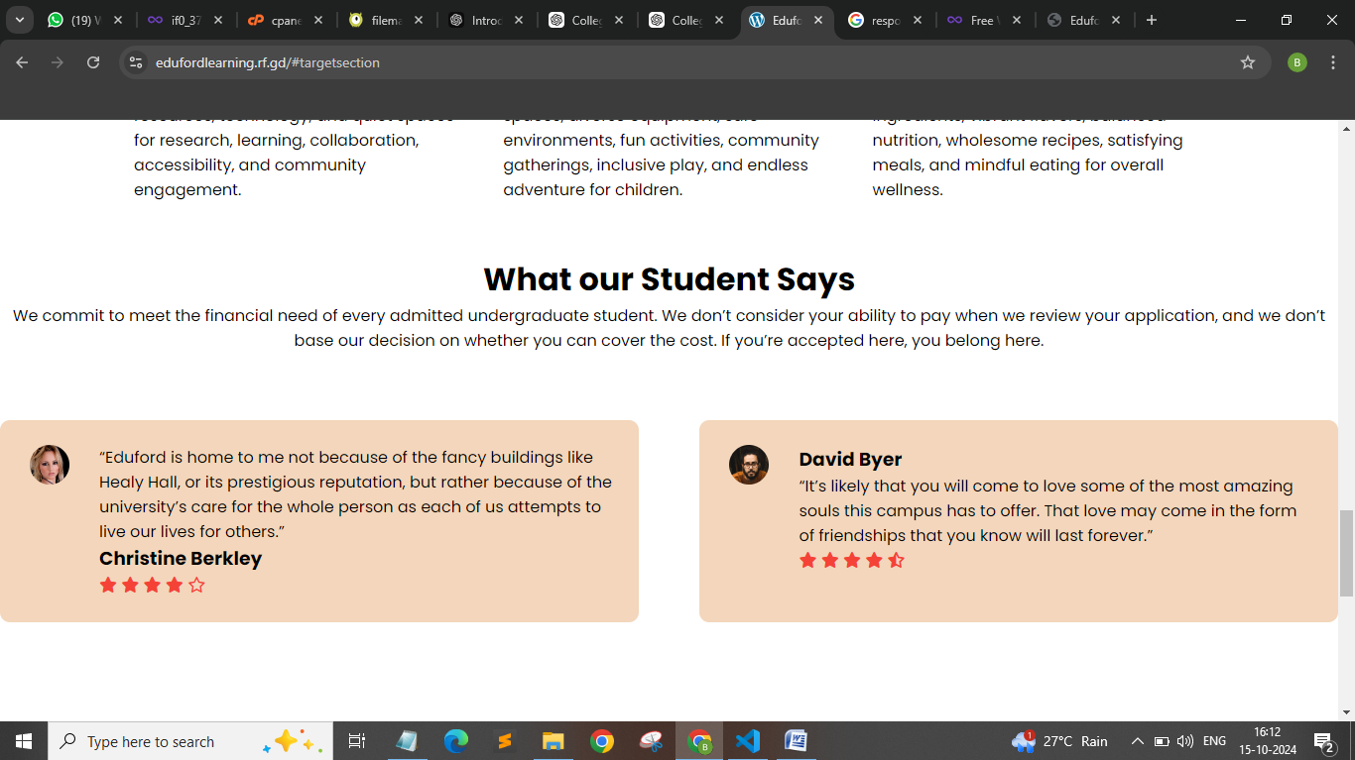
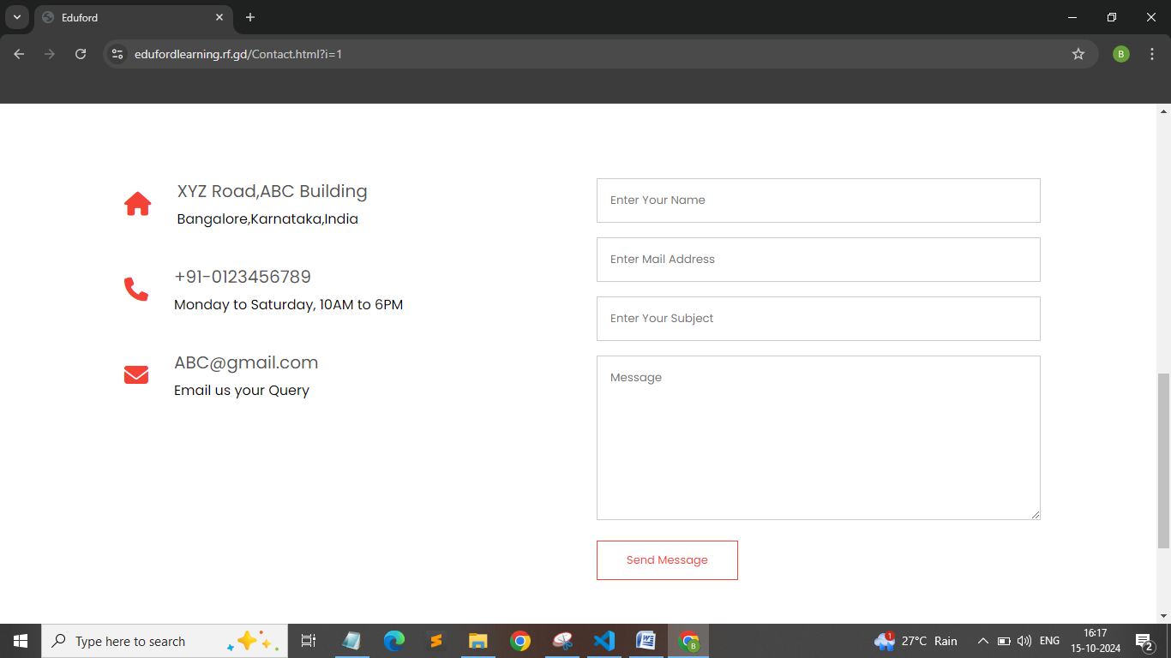

Slide 9
Conclusion
The College Review Website serves as an essential resource for students seeking comprehensive information about colleges, courses, and educational opportunities. By combining detailed college profiles, insightful blogs, and an easy-to-navigate design, the platform empowers users to make informed academic choices. The website's responsiveness ensures accessibility on various devices, making it a valuable tool for prospective students. Moving forward, future enhancements can further improve user engagement and content richness, such as integrating user reviews and expanding the course offerings. Overall, this project successfully addresses the needs of students in their educational journey.

